Slide 1
File Processing
Simplified view of File System & File I/O

Slide 2
References
File Descriptor: https://www.computerhope.com/jargon/f/file-descriptor.htm
File System: https://slideplayer.com/slide/5229567/
File Structure: https://www.mysterybox.us/blog/2017/7/27/protecting-your-digital-assets-part-3-recovering-from-failure
https://www.programiz.com/c-programming/c-file-input-output#closing

Slide 3
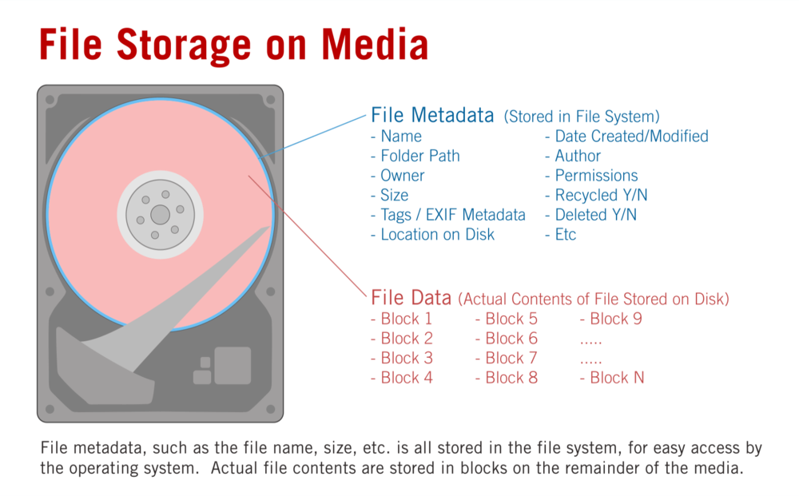
Files Storage
Files are stored in external storage
HD
SSD (these days)
Other storage mediums
Occasionally in RAM!
We are essentially talking about files in HD in the presentation
File includes Meta Data and & File Data
Both data are stored in external storage
Inode is a pointer to Meta-Data
Name
Folder Path
Owner
Size
Permission
Date Created/Modified
Etc.

Slide 4
File Cluster - Chaining
Typically, a large file is stored in multiple clusters
The clusters are chained using pointers
The Meta Data for a file includes a pointer to the first cluster of the file
Example: File 2 contains 4 clusters
Indexing can also be used as an alternative to chaining
1
36
Why a file is in multiple discontinuous clusters?

Slide 5
File system
User Prog
User
process
stdio Library
File System
File System
Operating
System
Storage
Driver
Disk
Why File System Abstraction?
Why do we need File System Abstraction in OS?

Slide 6
Communicating with OS
User Process
signals
systems calls
System call
Request to the operating system to perform a task that the process does not have permission to perform
Signal
Asynchronous notification sent to a process from OS to notify the occurrence of an event
Standard Library Calls
Generic I/O support
A smart wrapper around I/O-related system calls.
This means, system calls are normally embedded in some library calls.
Operating System
Ready Processes queue
Processor
Blocked Processes queue
Process

Slide 7
System Calls
Method for user process to invoke OS services
Called just like a function Call; a “protected” function call
The control is transferred to OS and back
User
Process
Application
OS
File System

Slide 8
Implementing a System Call
System calls are implemented using Software Interrupt (SWI) AKA trap
OS is given control through trap
Switches to supervisor mode
Performs the service
Switches back to user mode
Gives control back to user
1: close
2: Read Int
3: Read Char
4: write Int
5. Open File
…
SWI 0x05
Reason for invoking SWI
Trap to the OS
System-call specific arguments are passed with SWI
Notes:
“int $0x80” transfers to a particular point in the OS code, saves all of the registers, checks that a valid system call was invoked (i.e., range checking on eax), and transfers control to the code for the specific system call (using an offset table indexed by eax)

Slide 9
Library and API
Library implements reusable code that saves time
Library and API are related terms
Like other C functions, library functions have
Declaration part (API)
Definition part

Slide 10
Library Declaration and Definition
Declaration
Definition
Notes:
Those functions are that useful to multiple programs is implemented as library
Library enables reuse of code and saves time
Library and API related terms
Declaration of the library functions is API; and implementation (definition) of declared functions is library
API is programmers’ interface unlike UI or GUI
In scripting languages, libraries are referred to as packages
In C programming, the library functions are declared in “.h” file - Example: stdio.h
The functions themselves are defined in “.c” file and compiled as “.lib” or “.dll” – Example: stdio.lib
Library function is accessed by including the header file in program and linking the lib file at compilation

Slide 11
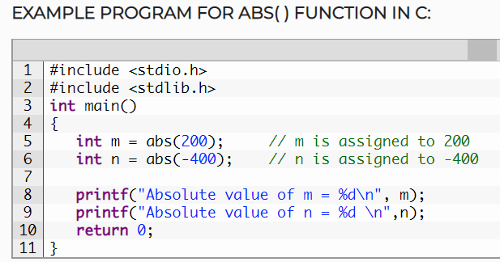
Using Library Function

Slide 12
Integrated Development Environment (IDE)
An IDE is an integrated set of tools and libraries.
An IDE makes program development easier
An IDE can support programming with multiple languages
Example: Microsoft Visual Studio and Arduino IDE
Walkthrough demonstration of Visual Studio

Slide 13
IDE – Tool Chain, Libraries
Notes:
The tool set or tool chain in an IDE typically includes: Editor, Formatter, Compiler, Linker, Loader, & debugger, etc.
The libraries included in an IDE are platform and language specific
Example: Window specific libraries - Winsock, Winpcap

Slide 14
Framework
Like library, a Framework also enables code reuse
A framework offers customizable generic programs and libraries for a specific Application
Framework: Developer’s code is embedded to framework to create custom application – on the other hand
Library: Library code is embedded within developer’s code

Slide 15
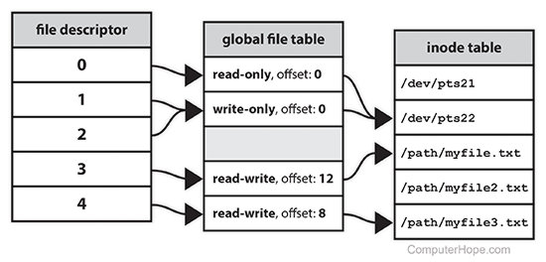
File Handle
When a process makes a successful request to open a file, the OS returns a file descriptor which points to an entry in the OS’s global file table.
The file table entry contains pointer to inode of the file, byte offset, and the access restrictions etc.
The inode is the Meta Data for a file

Slide 16
Special Files: STDIN, STDOUT, and STDERR
Name | File descriptor | Description | Abbreviation
Standard input | 0 | This defaults to keyboard input from the user. | STDIN
Standard output | 1 | This defaults to the user's screen. | STDOUT
Standard error | 2 | This defaults to the user's screen. | STDERR
Your File | 3 | In HD | filename

Slide 17
File with Tcl
Why Tcl? Simpler and easy to work with in classrooms. Our objective here is to learn File I/O not to deal with logistical issues. Here also we may encounter syntactical issues, but we can build and test code faster

Slide 20
File I/O – Example
proc fileRead {fname} {
set fd [open $fname r]
while {![eof $fd]} {
set line [gets $fd]
puts $line
}
close $fd
}

Slide 22
Hexdump
Hexa decimal dump of file can allow us to seen the content of file with control characters like <LF>(\n -0xd) and <CR> (\r - 0Xa) etc
Hex Editor Neo – Download and install on your laptop
Use this to view the content of a file
Understand how cursor movement over file treats <LF> and <CR>

Slide 24
Exercise
Open a file (input.txt) in a read mode
Open another file (output.txt) in Write mode
Copy the contents of input file to output file
Close both files – validate your program
Check out the cursor position while reading the content of a file
Move the cursor to the print and read it again

Slide 25
ARMSIM
File Processing & Embest Peripherals

Slide 26
ARM Assembler Directives
Assembler directives are instructions to assembler
Assembler directives are used for initializing memory, creating symbolic literal, etc
Do not interleave Assembler instructions with Assembler directives
It is good practice to have all the directives either at the top or at the bottom
Hello: .asciz "Hello Class\n“
Address: .word 0
.equ SEG_A, 0x80
.equ Ten, 10
.set counter, 1
.set counter, counter+1
.align
For a Comprehensive list of ARM Directives refer the following: https://community.arm.com/processors/b/blog/posts/useful-assembler-directives-and-macros-for-the-gnu-assembler
Notes:
To create an equate, which is a symbol that is used only while assembling your code, you can use the .equ directive:
.equ lives,3
...once the symbol is defined, its value can not be changed in the remaining part of the source code.
On the other hand –set directive allows the symbol values to be updated

Slide 27
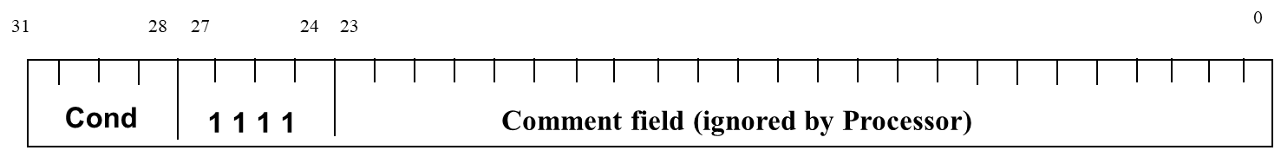
Software Interrupt (SWI)
SWI is one of the special ARM assembly instructions
In general, SWI invocation behaves like a function call
Invocation of SWI passes the control to Privileged System
SWI is a single operand instruction; operand size is 24-bits in size
The operand value informs the system the reason for invoking SWI
ARM SWI is used to perform privileged functions
ARMSim uses this mechanism in supporting two Plugins
Reason for invoking SWI
Op Code
Operand

Slide 28
ARMSim and SWI
ARMSim uses SWI to support File I/O and other Simulator specific Peripherals (Embest Plugin)
Example:
Open File: SWI 0X66
Close File: SWI 0X68
More on following slides

Slide 29
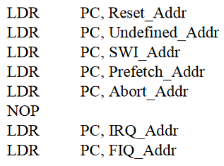
Handling SWI with Vector Table
When an exception occurs, the core:
Copies CPSR into SPSR_<mode>
Sets appropriate CPSR bits (especially the mode)
Maps in appropriate banked registers
Stores the “return address” in LR_<mode>
Sets PC to vector address - 0x00000008
To return, exception handler (sw) needs to:
Restore CPSR from SPSR_<mode>
Restore PC from LR_<mode>
Leave data in designated registers (return values)
.
.
.
Notes:
LDR versus MOV
MOF immediate operands are limited to 8 bit value
LDR immediate operand can be full size (16/32 bits) depending upon the ARM Processor
Values from memory can be moved to Register with LDR
MOV is restricted to move between registers
SPSR – Stored Program Status Register
Exceptions, in order serviced, are:
Reset - supervisor mode
Data abort - abort mode
External Fast Interrupt Request - FIQ mode (eg DMA)
External Interrupt Request - IRQ mode
Instruction Prefetch abort - abort mode
Software Interrupt (SWI)- supervisor mode (typically used to extend operating system)
Undefined instruction - undefined mode
Only one memory location for each vector
Each vector contains branch to that particular exception handler
FIQ vector is last one. This allows its handler to be run sequentially from that address, removing need for branch and its associated delays. Important because speed is essential for FIQ.
Interrupt routine’s responsibility to clear interrupt condition.
Can return using one instruction
See exception handling module for details.

Slide 30
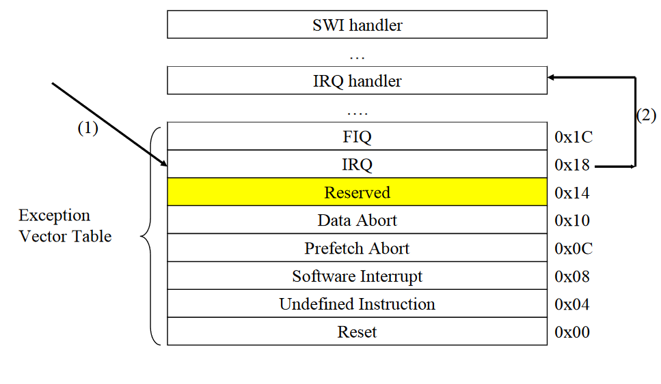
SWI Handler
Codes handler for various values of operand, like file close, open etc
FCS
RCS
…

Slide 31
ARMsim* – File I/O Plugin Exceptions

Slide 32
Printing a Character & a string to STDOUT
Hello: .asciz "Hello Class!\n"
mov r0, #'1'
swi 0x00 ; character in r0 to stdout
mov r0,#':'
swi 0x00 ; character in r0 to stdout
ldr r0, =Hello ; load starting byte address
swi 0x02 ; string to stdout
Swi 0x11 ; Halt
File Handle/Descriptor Size is 1 Word;
FD 0 for STDIN, FD 1 for STDOUT, and FD 2 for STDERR

Slide 33
ARM SIM – Opening a File for Input/Output
FileName: .asciz “test.s"
.align
FileHandle: .word 0
ldr r0,=FileName
mov r1,#0
swi 0X66
ldr r1,=FileHandle
str r0, [r1]
swi 0x11
Opening a file for output is done by changing #0 to #1 in line 5

Slide 34
ARM SIM – Reading a string from a file
ldr r0,=FileHandle
ldr r0, [r0]
ldr r1,=CharArray
mov r2,#80
swi 0x6a
bcs ReadError
...
FileHandle: .word 0
CharArray: .skip 80
Error handling is critical to developing good program

Slide 35
ARM SIM – Writing a string to a file
ldr r0,=OutFileHandle
ldr r0,[r0]
ldr r1,=TextString
swi 0x69
bcs WriteError
...
TextString: .asciz “Hello!\n "
The file handle for STDOUT is #1. No need for Open for STDOUT, STDIN and STDERR

Slide 36
File Close

Slide 37
ARMSIM – Working with Embest Plugin
Embest plugin includes a number of simple I/O devices
8-segment display, LED lights, Input toggle buttons, and a numeric key board
SWI implementation supports exception handling to work with these devices

Slide 38
ARMSIM – Embest LED – Exception Code
mov r0,#0x02
swi 0x201 ; left LED on
mov r0,#0x01
swi 0x201 ; right LED on
mov r0,#0x03
swi 0x201 ; both LEDs on
mov r0,#0x00
swi 0x201 ; both LEDs on
Read and understand the SWI Exception tables for both I/O and Embest Plugin
No need to remember the exception or code

Slide 39
Exercise
Read Section 9 of ARMSim User Guide with objective to write code for Embest Board Plugin
This section will not be taught in the class!

